Slide 1
GSERM: Text Mining & NLP TM Basics

Slide 2
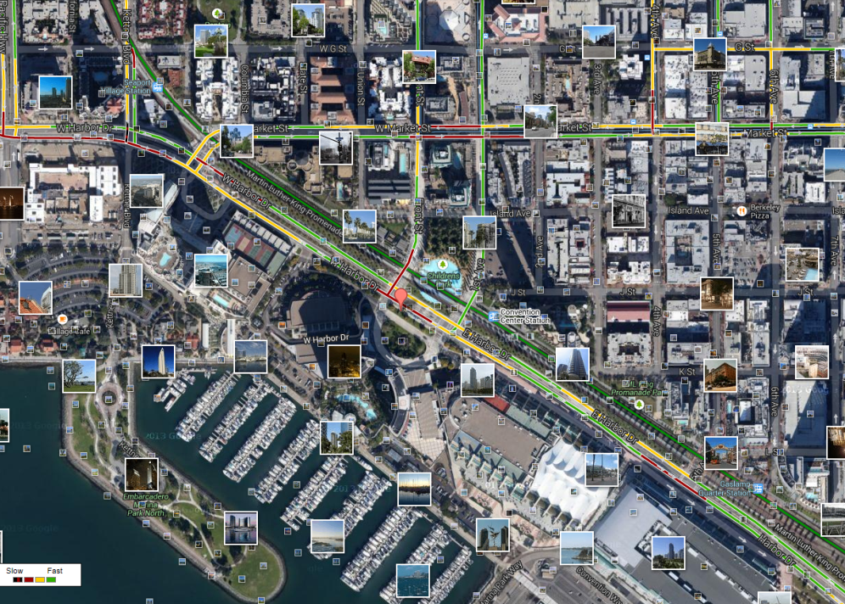
What is Text Mining?
Before Text Mining
Extract new insights from text
Let’s you drink from a fire hose of information
Language is hard; many unsolved problems
Unstructured
Expression is individualistic
Multi-language/cultural implications

Slide 3
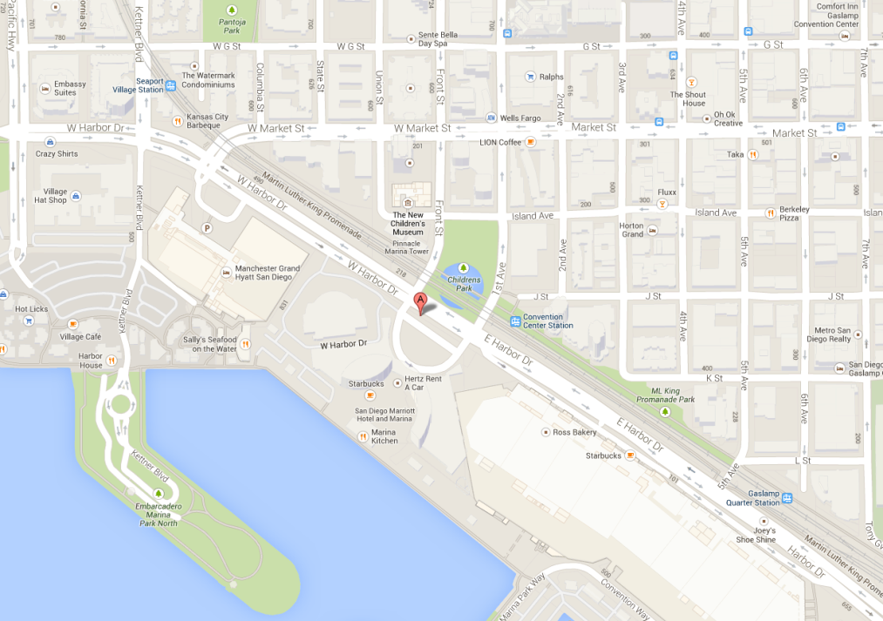
What is Text Mining?
After Text Mining
Extract new insights from text
Let’s you drink from a fire hose of information
Language is hard; many unsolved problems
Unstructured
Expression is individualistic
Multi-language/cultural implications

Slide 4
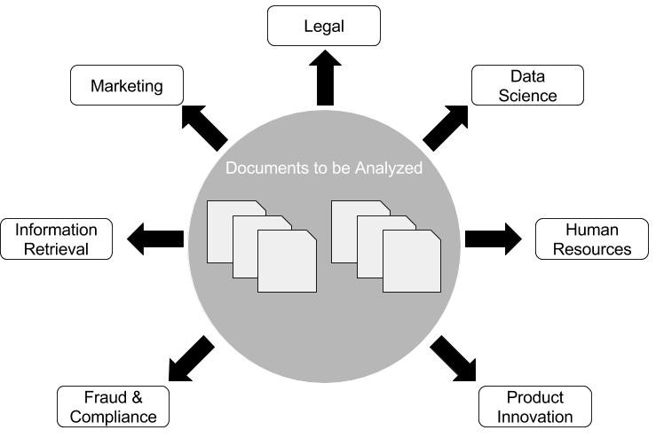
Where can NLP & Text Mining be used? Anywhere there are documents!

Slide 5
What uses of text mining & NLP do you observe, research or want to do?

Slide 6
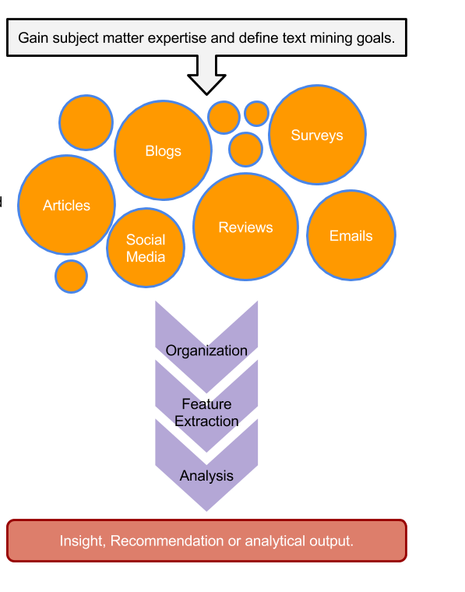
TM Project Workflow
Unorganized State
Natural Language Processing & Analysis
Organized State

Slide 7
Text Mining Workflow
Problem Definition
Identify Text Sources
Text Organization
Feature Extraction
Analytics
Reach Insight or Recommendation

Slide 8
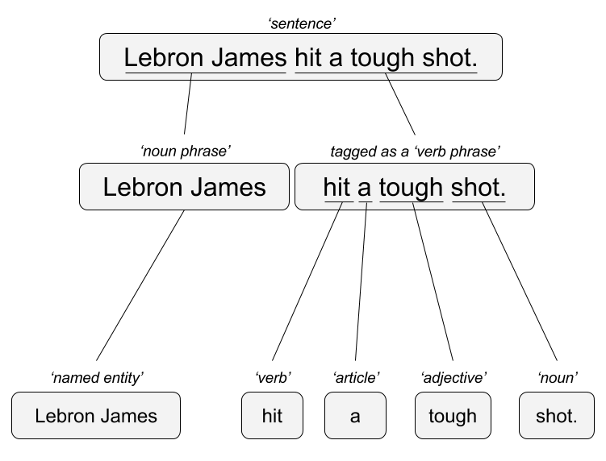

Two Popular Approaches
“Lebron James hit a tough shot.”
Syntactic Parsing
Bag of Words
Lebron
a
James
hit
tough
shot
*There are other approaches usually based on DNN, that I refer to “abstractive”

Slide 9




TM Challenges - Disambiguation
I made her duck.
I cooked waterfowl for her to eat.
I cooked waterfowl belonging to her.
I created the (clay?) duck and gave it to her.
Duck!!

Slide 10
TM Challenges - Misc
Other Challenges
Examples
Compound words (tokenization) change meaning
Sarcasm
Cultural differences
“Bad” vs “not bad”
“I like it…NOT!”
“It’s wicked good” (in Boston)

Slide 11





Why text mining is an art & science?
Challenges because human expression is diverse, often ambiguous, affected by age, demographics, socio-economics, medium/channel & regional attributes of the author.
Common Sources
Source & context are important, directly impacting data integrity.
Books
Electronic Docs (PDFs)
Blogs
Websites
Social Media
Customer Records
Customer Service Notes
Notes
Emails
Legal Documents
…

Slide 12



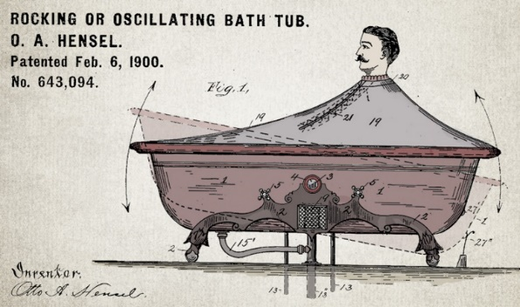


Channel affects language
Legal documents are verbose & technical.
“Be the change you want to see in the world.”
“kappa” indicates sarcasm, irony,
or a joke among online gamers.
Expression is context specific making analysis challenging.

Slide 13



Messenger affects language
Boomers 1946-1964
* Make a difference * Consensus/team * Experiment/try new things * “Imagine if…” * Save time * Features and benefits
Gen X 1965-1980
Best, finest, world-class
“You will benefit by…”
”This is in your best interest.”
Gen Y 1981-2000
Global citizen
Balance
Diversity
Community/connections
Beyond generation, other factors like socio-economic, gender & demographic makeup impact expression.
https://www.anneloehr.com/

Slide 14


Gen Y/Z expression is evolving rapidly due to technology.
“Thank you, next.”
“Woke”
“Cray”
“Gucci”
“Squad goal”
“Bible…”
“Adulting”
“Turnt”
“Hundo P”
“Trill”
“TFW”
Beyond generation, other factors like socio-economic, gender & demographic makeup impact expression.

Slide 15
Gen Y/Z expression is evolving rapidly due to technology.
“Thank you, next.” – moving on with positive connotation
“Woke” - The more woke one is, the more sympathetic & knowledgeable one is about a topic or type of person
“Cray” - crazy
“Gucci” – fine, good
“Squad goal” – friend group behavior
“Bible…” - what follows is TRUTH
“Adulting” – activities associated with growing up
“Turnt” – “turned up” i.e. really excited
“Hundo P” – agree “100%”
“Trill” – True & Real
“TFW” – “That Feeling When” to describe an emotion
Beyond generation, other factors like socio-economic, gender & demographic makeup impact expression.

Slide 16




Audience affects language
And we all context switch based on who we’re are speaking too.

